Slide 1
Lecture 6a Algorithm Analysis 4

Slide 2
The Limit Rule
Most powerful and versatile rule for evaluating orders of functions

Slide 3



The Limit Rule
If then f(n)=Θ(g(n))
If then f(n)=o(g(n))
If then f(n)=ω(g(n))

Slide 4

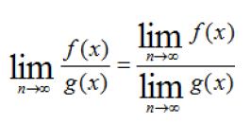


The l’Hopital’s rule
Often (but not always) to calculate we use the l’Hopital’s rule
We know that
The l’Hopital’s rule is applicable if
or

Slide 5

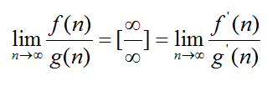
The l’Hopital’s rule

Slide 6
Recall from Mathematical Review
Limits
Derivatives

Slide 7
Usage of the Limit Rule
Direct – for determining the order of a function
In conjunction with the max rule - for determining the order of a function
To compare functions

Slide 8
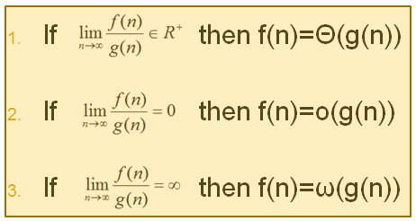
Usage 1
Prove that t(n)=5n²+2n=Θ(n²) (without using the theorem we studied before)
∴ t(n) = Θ(n²)
=

Slide 9
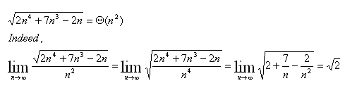
Usage 1
Prove that

Slide 10
Usage 2
Usage 2: In conjunction with the max rule - for determining the order of a function
Prove that t(n) = 5n²+1000log₁₀n³ = O(n²)
f_{n} = 5n²
g_{n} = 1000log₁₀n³
t_{n} = O(max(O(f_{n}),O(g_{n})))

Slide 11
Usage 2 continued
Prove that t(n) = 5n²+1000log₁₀n³ = O(n²)
f_{n} = 5n² = O(n²)
g_{n} = 1000log₁₀n³ = O(logn)
t_{n} = O(max(O(n²),O(logn)))

Slide 12
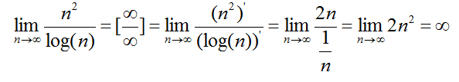
Usage 2 continued
Let us compare functions n² and logn (to find the max)
t_{n} = O(max(O(n²),O(logn))) = O(n²)

Slide 13

Usage 3: Comparing functions
Recall the next slide
Where is the place of

Slide 14
Typical Growth Rates (Most Common Efficiency Functions)
linearithmic f.

Slide 15
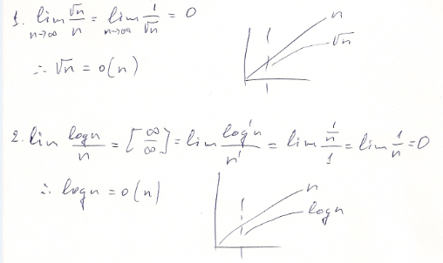

Slide 16
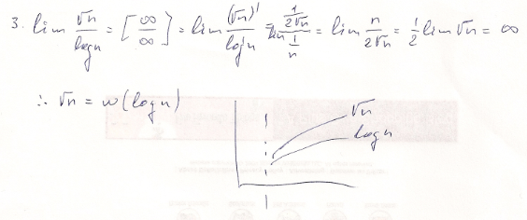

Slide 17
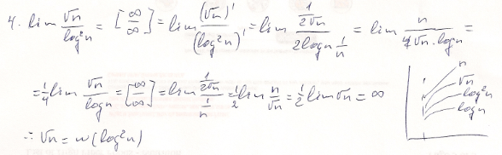

Slide 18
Example
Compare a^{n} and b^{n}, where a,b>0

Slide 19
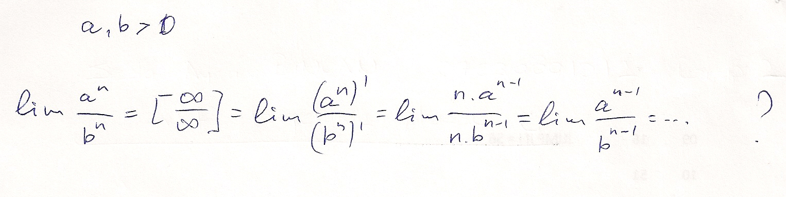
If a, b > 1

Slide 20
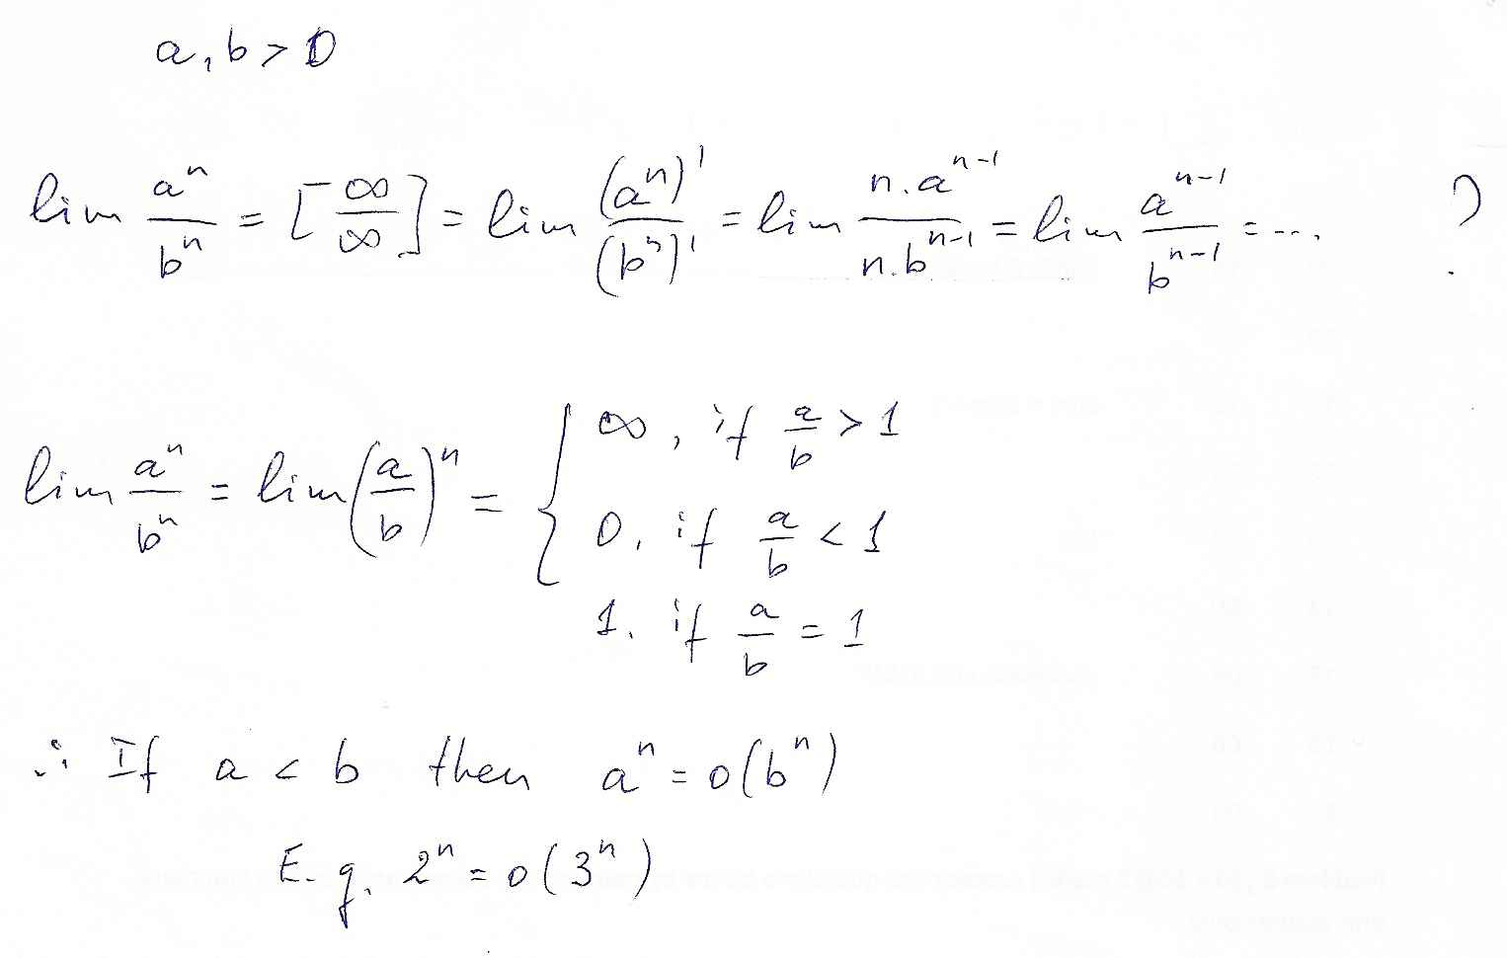
If a, b > 1

